Slide 1
Whole Networks & Dynamics

Slide 2
Units of Analysis
Social Network Analysis
  vertices (people)
  dyads
Network Science: whole networks
Compare different networks
  How are they similar
  How do they differ

Slide 3
Social and physical scientists tend to have different goals. In the physical sciences, it has not been unusual for a research paper to have as its goal to demonstrate that a series of networks have a certain property (and that this property would be rare in random networks). For social scientists, the default expectation has been that different networks (and nodes within them) will have varying network properties and that these variations account for differences in outcomes for the networks (or nodes).
Borgatti, Stephen P., et al. "Network analysis in the social
sciences." Science 323.5916 (2009): 892-895.

Slide 4



Network Properties
Size: Number of edges (E), Number of Vertices (N)
Density:
Average Degree

Slide 5
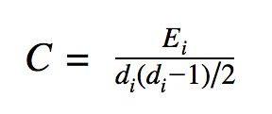
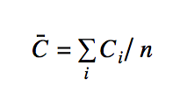
Network Properties
Largest Component Size: fraction of vertices in largest component
  how connected is the network
Average Clustering Coefficient
where E_{i} is number of edges among i’s alters

Slide 6
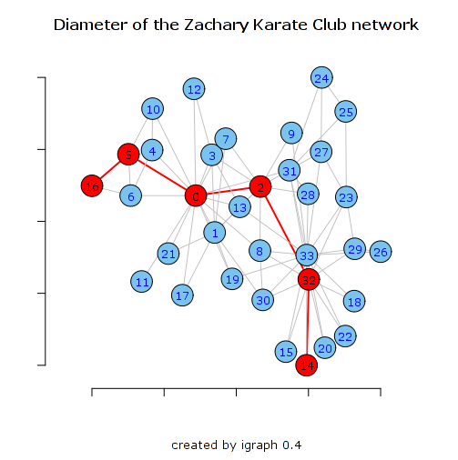
Diameter
Geodesic distance: l_{ij}
  shortest number of hops from i to j
  shortest path length
Diameter: Longest shortest path: max l_{ij}
Average path length

Slide 7
Assortativity
Dyad level - homophily
Network - assortativity
  correlation between values of the two vertices
Degree assortativity
  high degree nodes more likely to have ties with other high degree nodes
  low degree nodes more likely to have ties with other low degree nodes

Slide 8
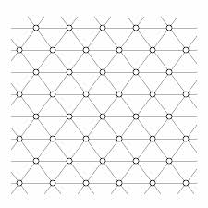
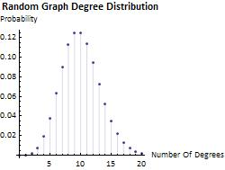
Random Graph
Place links randomly between pairs of vertices
some vertices will have more edges, others less
but on average a vertex will have
degree distribution across all vertices will be a poisson (normal) distribution (where mean=median=mode)
can also look at variance (standard deviation) around the mean
  centralization measure
But is this what we find in social networks?????

Slide 9
Summary: Network Properties
Number of Vertices
Number of Edges
Size of largest component
Density (or average degree)
Degree distribution
Average Clustering Coefficient
Diameter
Average shortest path length
Degree Assortativity

Slide 10
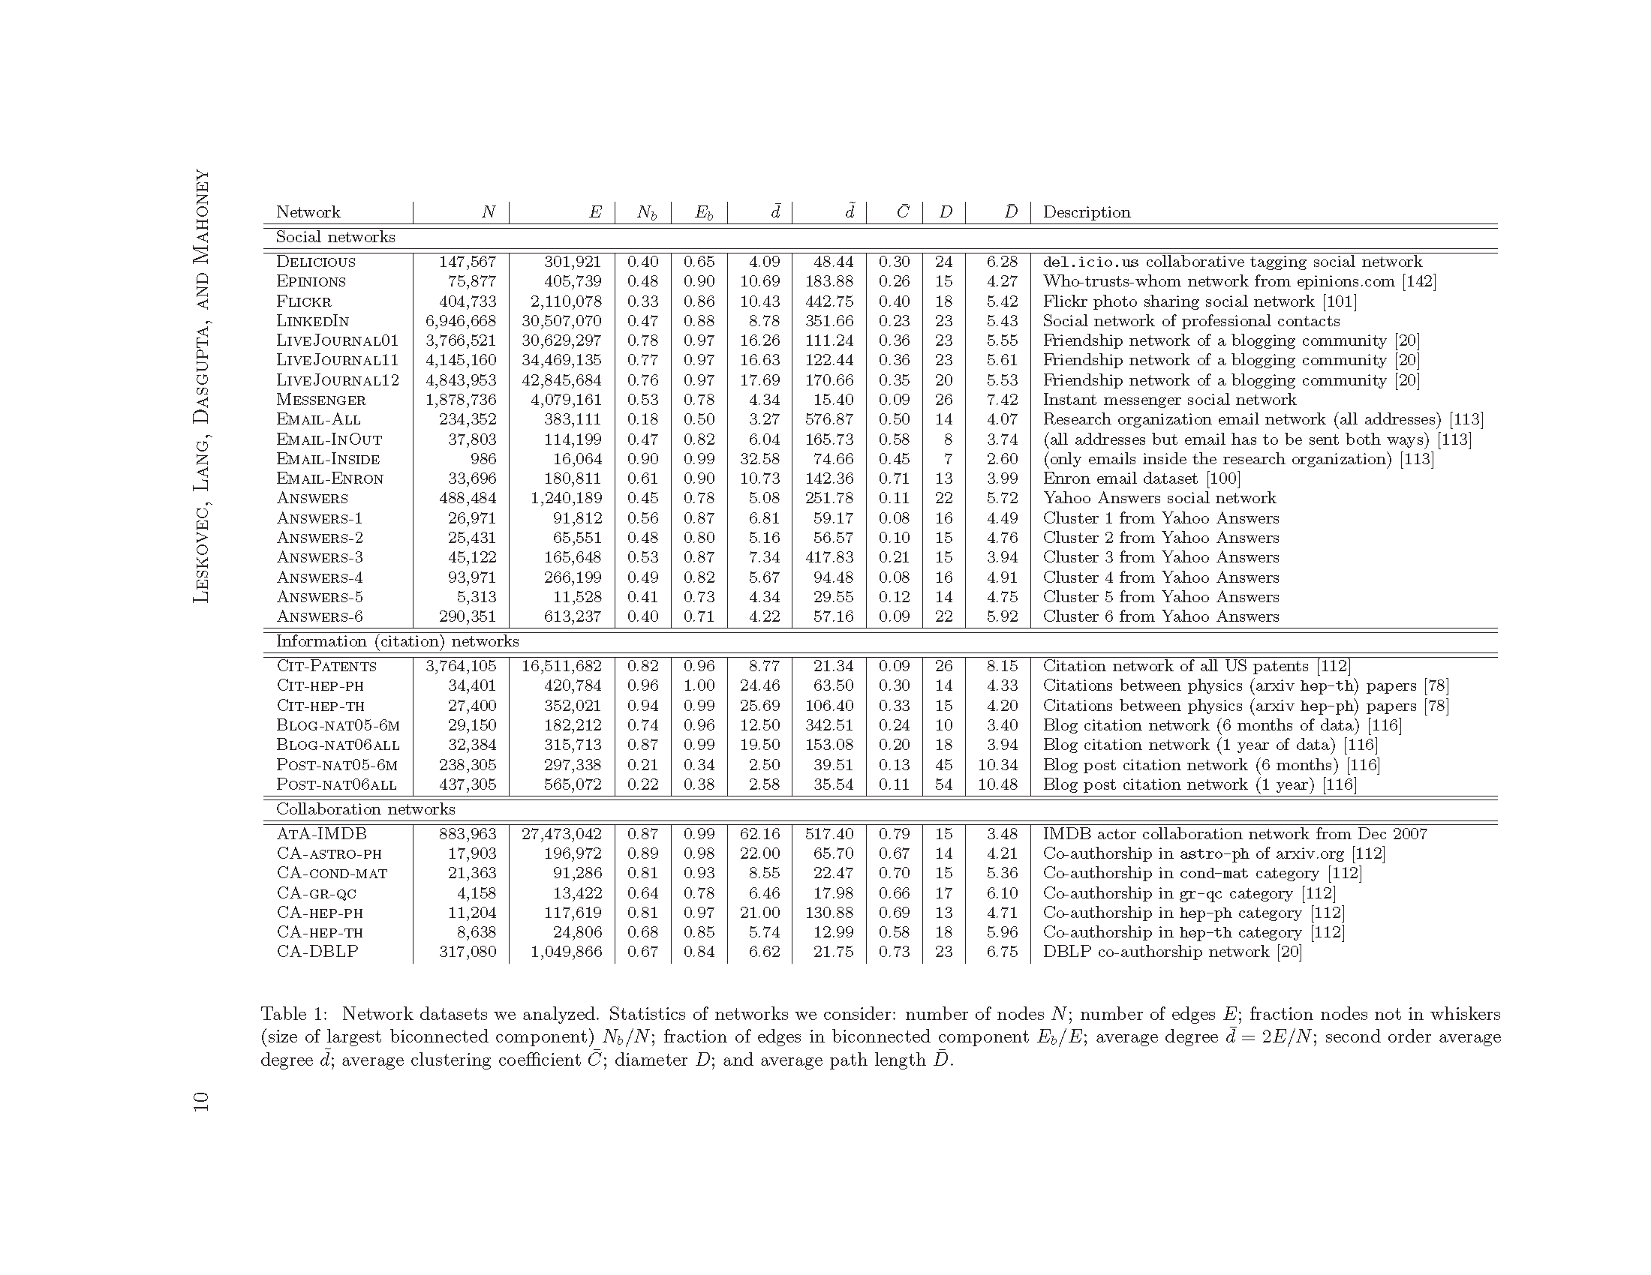
Leskovec, Jure, et al. "Community structure in large networks: Natural cluster sizes and the absence of large well-defined clusters." Internet Mathematics 6.1 (2009): 29-123.
https://snap.stanford.edu/data/

Slide 11
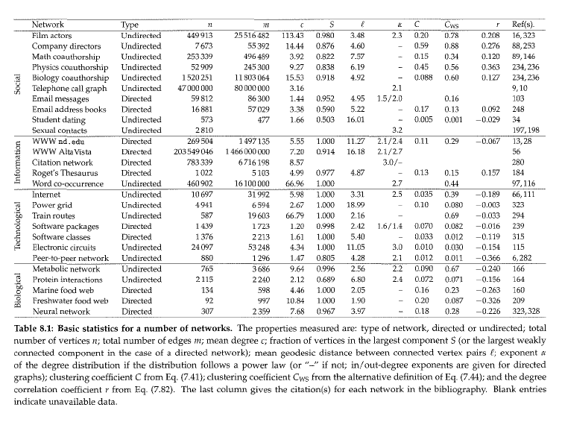
Newmann, Mark. Networks: An Introduction. Oxford University Press, 2010. p. 237

Slide 12
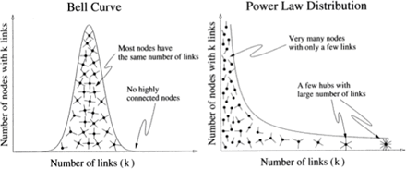
How to form a network - not random
If persons prefer to connect with those who are already connected…
    The distribution of connections gets a little funny

Slide 13
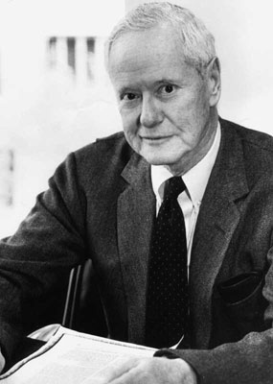
How to form a network
The “Matthew Effect”
  First noted by sociologist Robert Merton in the context of citations in science
    The consequence?

Slide 14
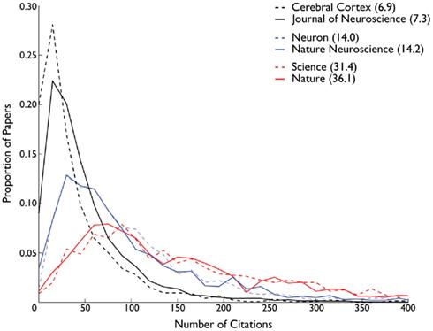
How to form a network
Papers that already have a lot of citations…
  More likely to be cited in the future

Slide 15
How to form a network
Papers that don’t have a lot of citations…
  Less likely to be cited in the future

Slide 16
How to form a network
The “Matthew Effect”:
  Does it “work” for other things?
    The World Wide Web (not to be confused with the internet!)
    Sexual networks (success breeds success)
    Corporate partnerships
    Hollywood actors
  Why?
    Each setting probably has its own “explanation”
      But general idea is that previous history of connections signals something desirable about that person
      e.g. “Rating/Dating” complex

Slide 17
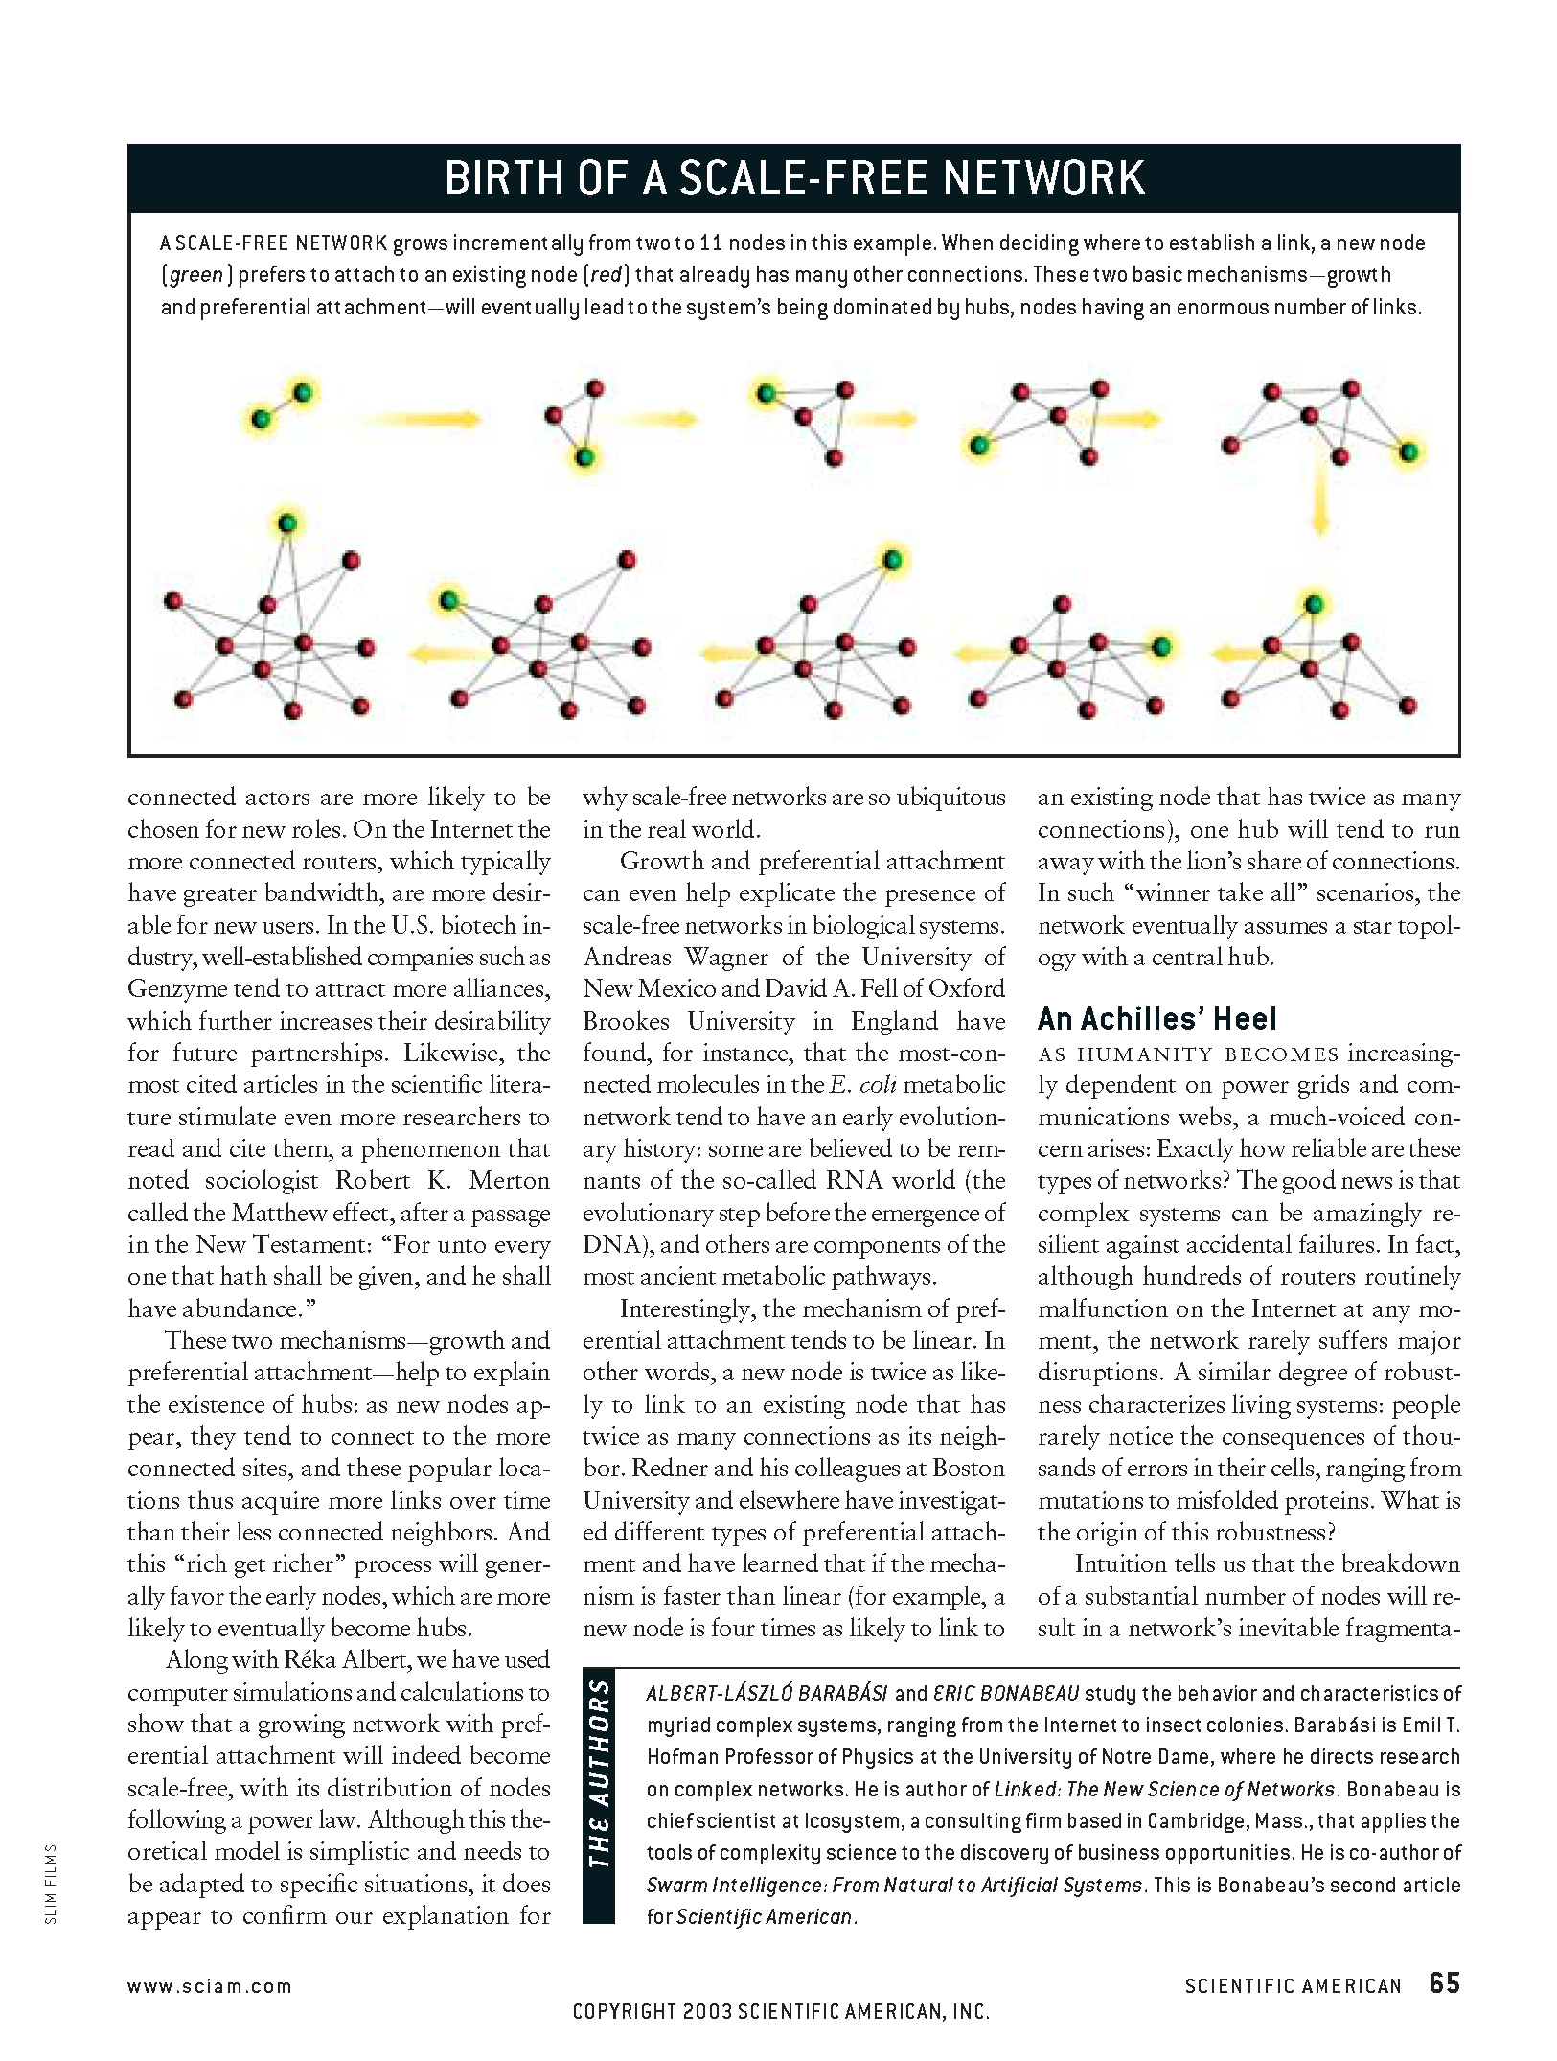
Forming a (scale free) network
General model:
    New people come into the network (network grows)
    When people enter the network they prefer to connect to people that already have a lot of connections

Slide 18
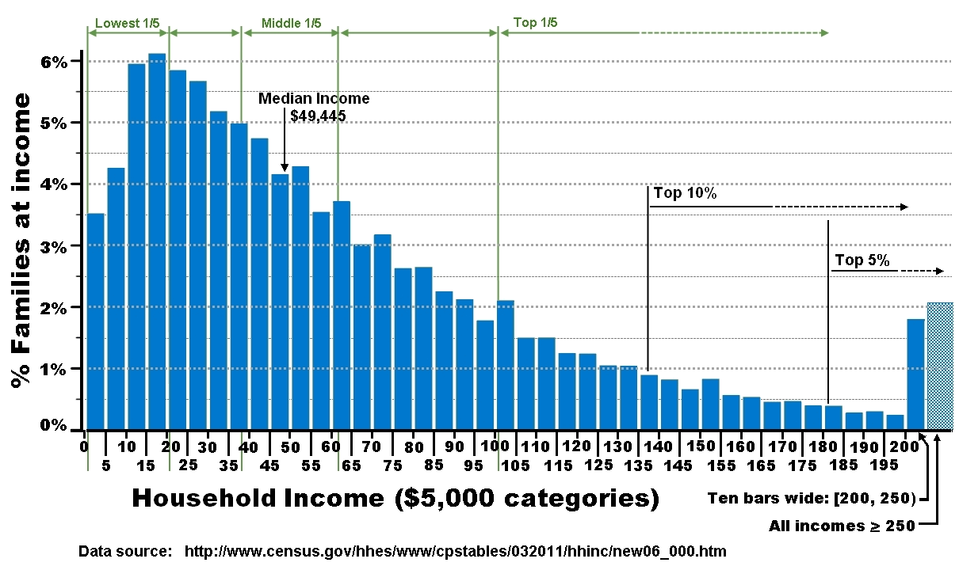
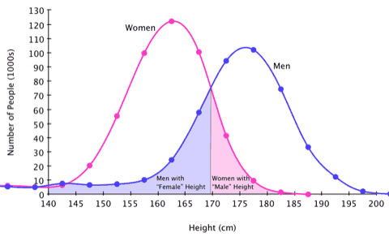
Forming a (scale free) network
This process generates a “scale free” network (in terms of ‘degree”)
  What the heck is a “scale”?
    It’s a metric researchers use to measure the amount of something

Slide 19
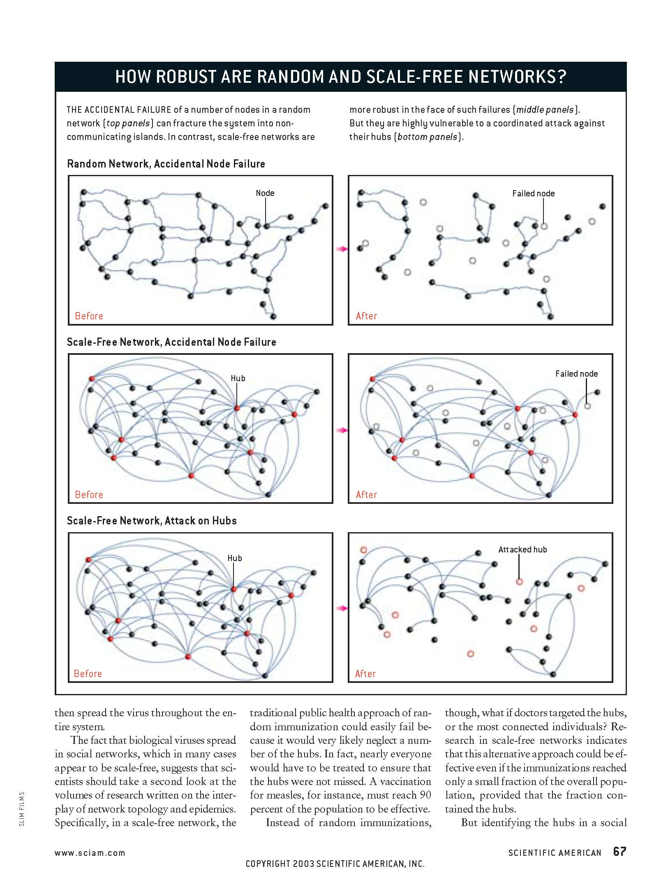
Properties of scale free nets
“Scale free” networks have a number of “good” properties
    They are resistant to disruption by the removal of any one single actor
      Why?

Slide 20
Properties of scale free nets
Scale free networks have a number of “good” properties
    But they are vulnerable to targeted attacks
      Why?

Slide 21
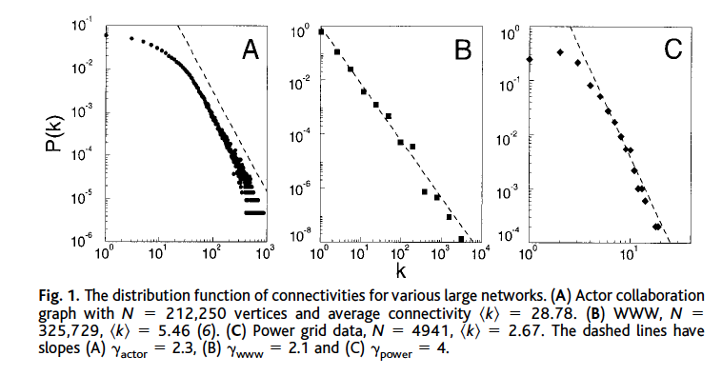
Preferential Attachment
Preferential Connectivity
  Probability a new vertex will connect to another vertex is a function of the degree of the other vertices
  P(k) ~ k ^{-y}

Slide 22
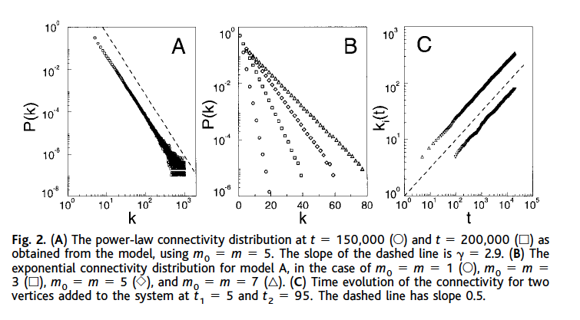
Properties of PA Model
Power-law degree distribution
  linear on log-log scale
  hubs
  y ~ 2.5 - 3.0
scale-free (invariance)
  percent increase in k --> percent increase in P(k)
  no mean (average, norm)
  self-organized scale-free stationary state
  Small world
Notes:
in and out degree??
out - URLs found on HTML doc
in - links that point to doc *****
adding edges vs adding nodes
reattachment

Slide 23
Gould 2002
Hierarchies as status inequalities are emergent social process
  local actions (respect, liking, admiring)
  individual differences amplified
    via judgements of relative quality
  emergent social structure
Argument
  if no individual differences --> equality
  If differences, then through amplification --> inequality (star/hub)
  but social systems in between
  another social process -- reciprocity
    cost of liking A and not being liked by A

Slide 24

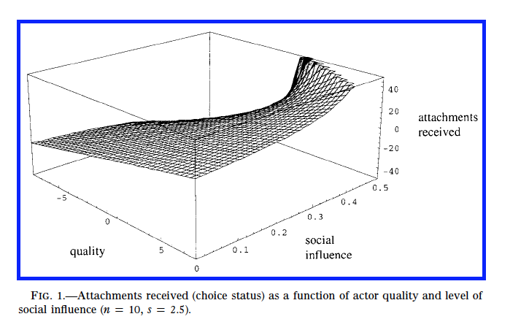
Amplification (of individual differences)
Weighted social influence (w) amplifies perception of quality
"a substantial intensification of status inequality as the importance of social influence relative to exogenous quality increases" (p. 1158)

Slide 25
Tradeoff
Attached to desirable others (preferential attachment) --> amplification of differences & inequality
attach to available others (reciprocity)
tolerance for non-reciprocity (s parameter)
  if painful --> attach to available others
    slows amplification process
  if not painful --> attach to desirable others
    acceptance of status inferiority

Slide 26
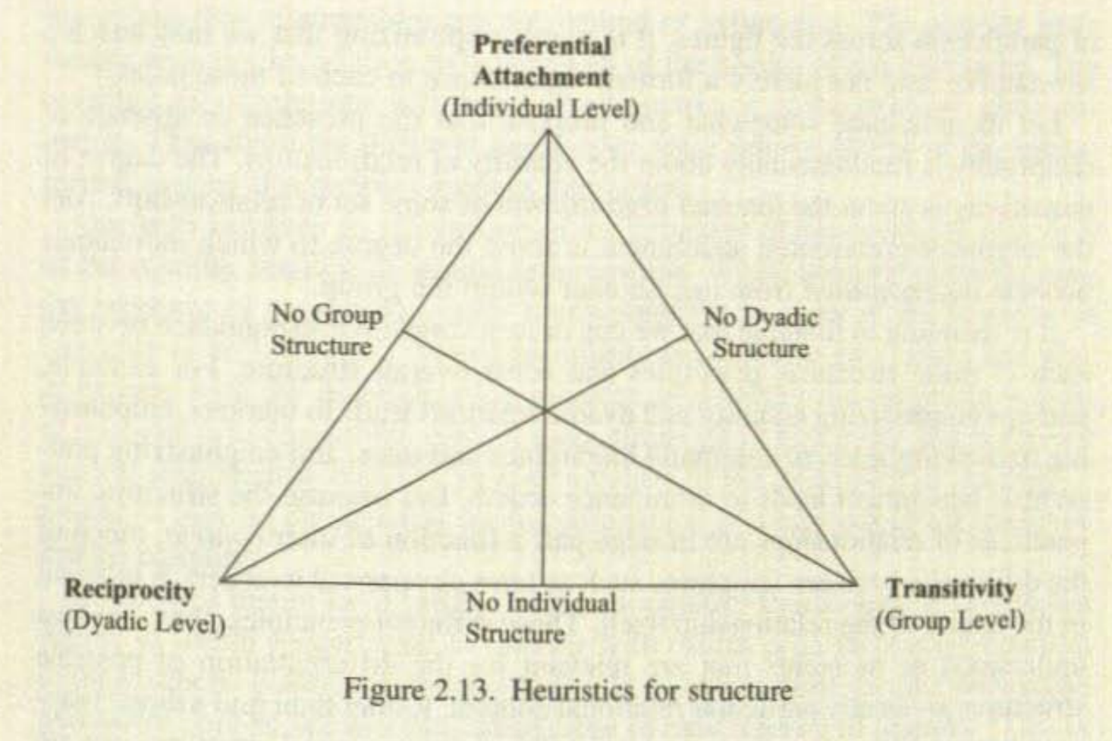
Martin’s Schematic Triangle

Slide 27
Preferential Attachment
Edros-Renyi (ER) random graph
  Probability 2 vertices connected is random and uniform
  Constant degree
  Low clustering
  Poisson distribution
    Probability of vertices with large k decreases exponentially with k
  Fixed N
Watts-Stogatz (WS)
  lattice with clustering
  random rewiring
  constant degree
  Fixed N
  Poisson Distribution

Slide 28
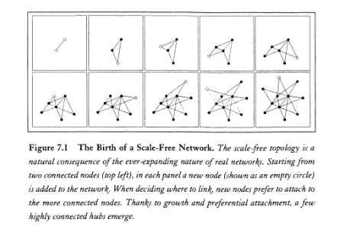
Preferential Attachment
Not fixed N: N varies over time
Probability two vertices are connected is not random or uniform

Slide 29
Forming a (scale free) network
Scale free networks have a number of “good” properties
    They are resistant to disruption by the removal of any one single actor
      Why?

